Slide 1
Database Programming
Phase 2
Aayush Jain

Slide 2
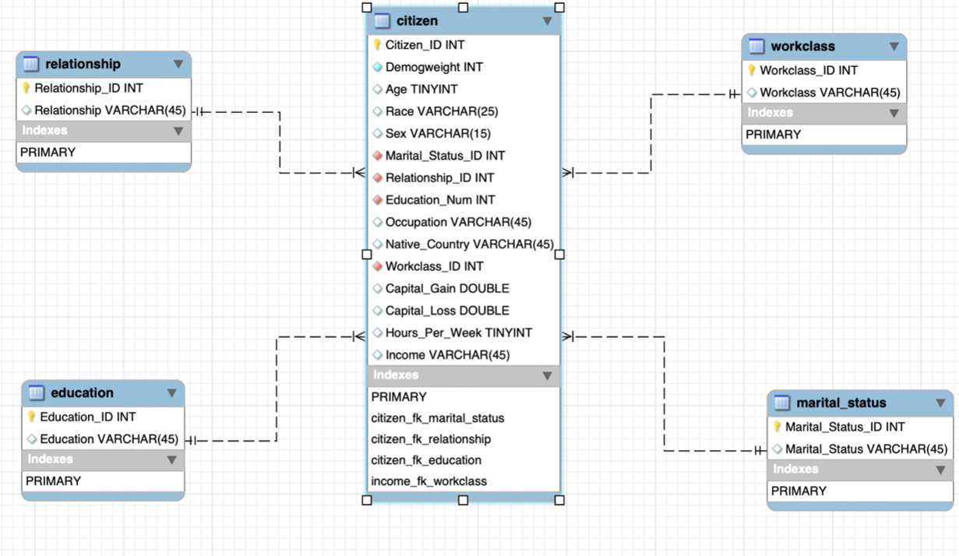
Updated ERD Diagram
Notes:
Erd vishal

Slide 3
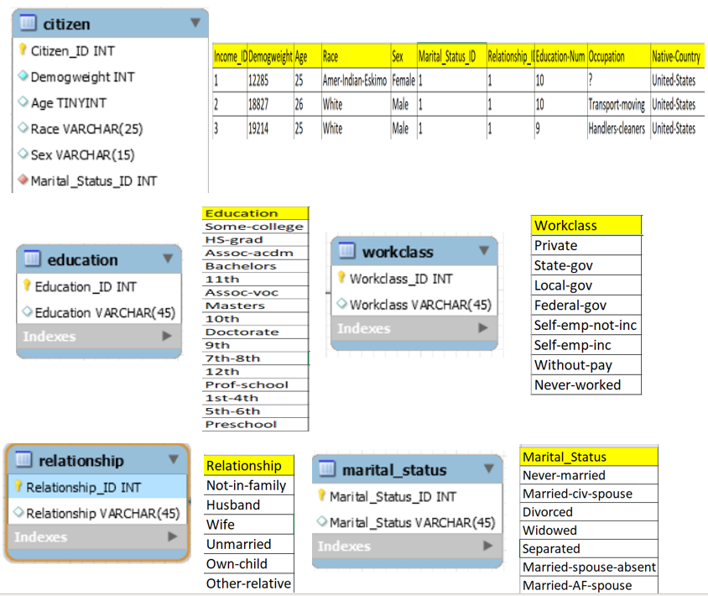
Steps followed for Data Cleaning and Extraction
From the main Adults Dataset we have partitioned the columns ‘Education’, ‘Workclass’, ‘Relationship’ and ‘Marital Status’ based on our table design.
Overall We have 5 tables and we prepared 5 different excel data sets to be imported into each of the tables.
For data cleaning we removed the duplicates in each columns for- Education, Workclass, marital status, relationship and used Vlookup to plugin to main Citizen table with these respective keys of each table.
Notes:
Data Extraction - Ram

Slide 4
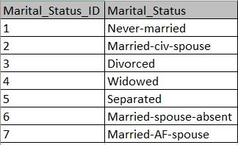
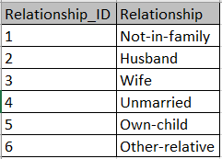
Dataset for Marital_Status Table
Dataset for Relationship Table
From Adults dataset we removed duplicates and extracted the unique columns based on our table design for
Marital_Status Table
&
Relationship Table
Notes:
Relation and marital Tables - ram

Slide 5
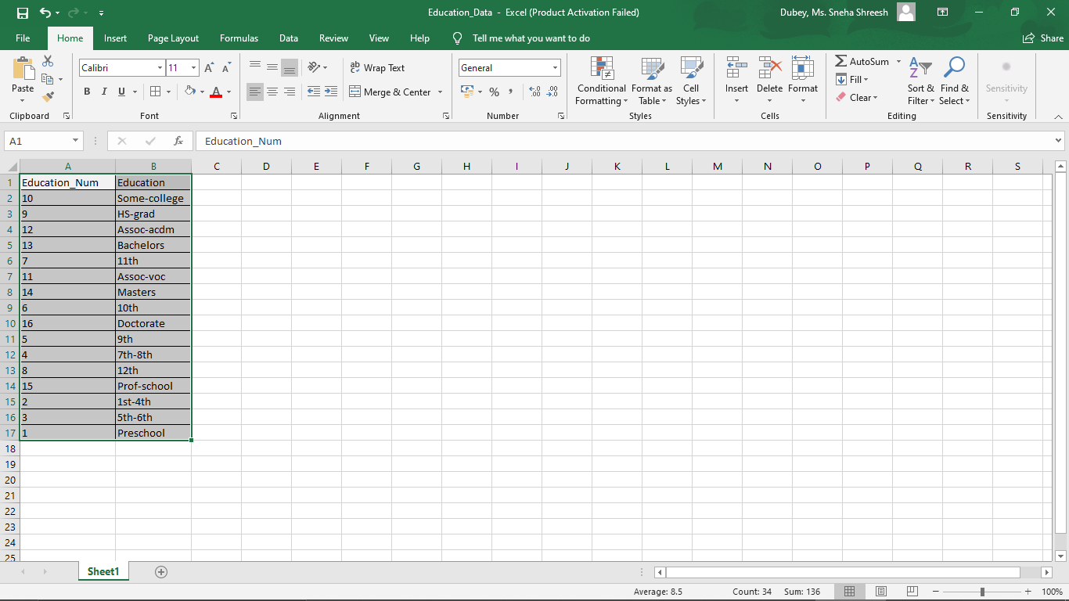
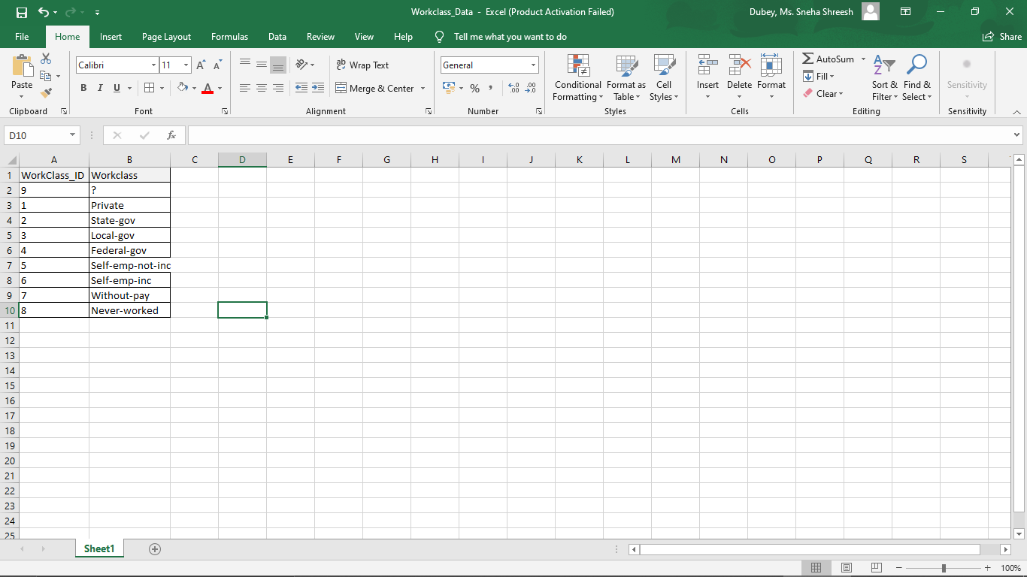
Dataset for Tables -Education & Workclass:
From Adults dataset we removed
duplicates and extracted the unique
columns based on our table design -
Education Table
&
Workclass Table
Notes:
Education and Workclass tables have been extracted doing data cleaning and both contain Unique ID’s and non duplicate values. The csv data was later imported into database along with other extracted data.

Slide 6
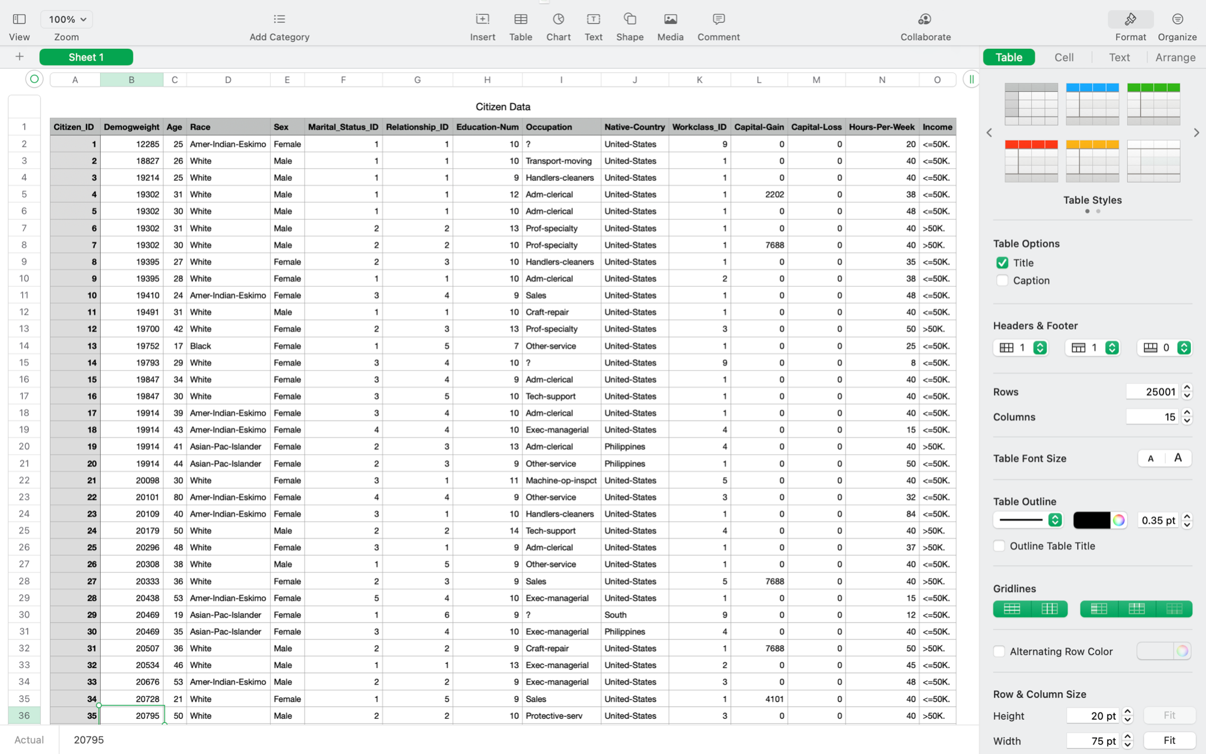
Dataset - Citizen Table
Notes:
Aayush

Slide 7
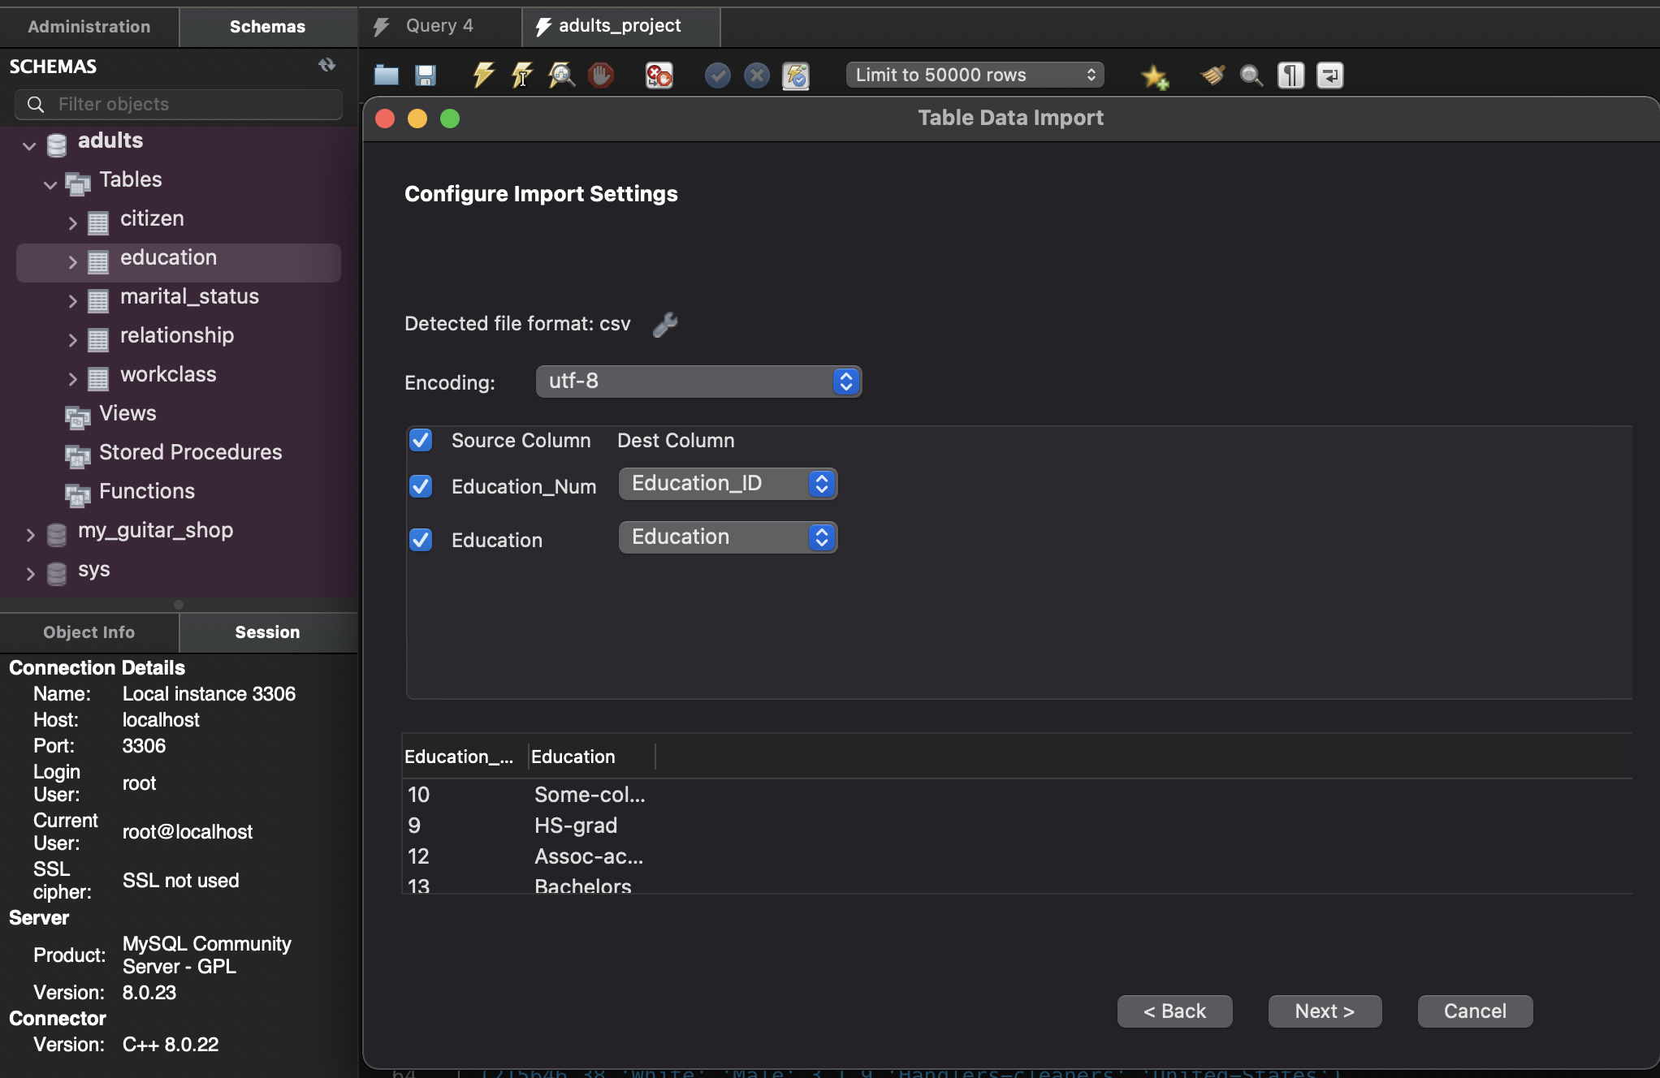
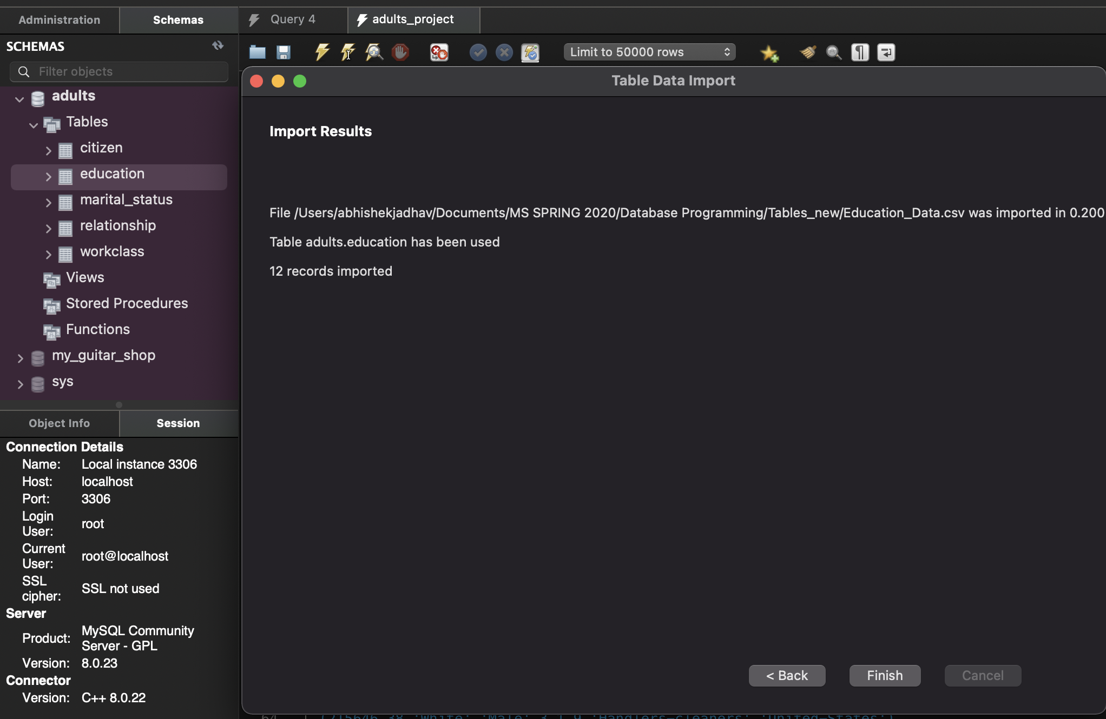
Import Excel files to DB
All the 5 excel tables which were created we imported it to adults db.
For that we converted the .xlsx format to .csv
Later, we imported it with UTF-8 encoding.
Finally, we have the updated records for all the tables.
Notes:
Abhishek - import excel to csv to database

Slide 8
The average Age for individuals in each of the Education and Occupation categories with Income more than $50,000 in each Native Country in ascending Age order.
Categorized all Native Country with Subcategories of all
→ Occupation
→ Education
→ With Average Age of citizens whose income is more than $50,000.

Slide 9
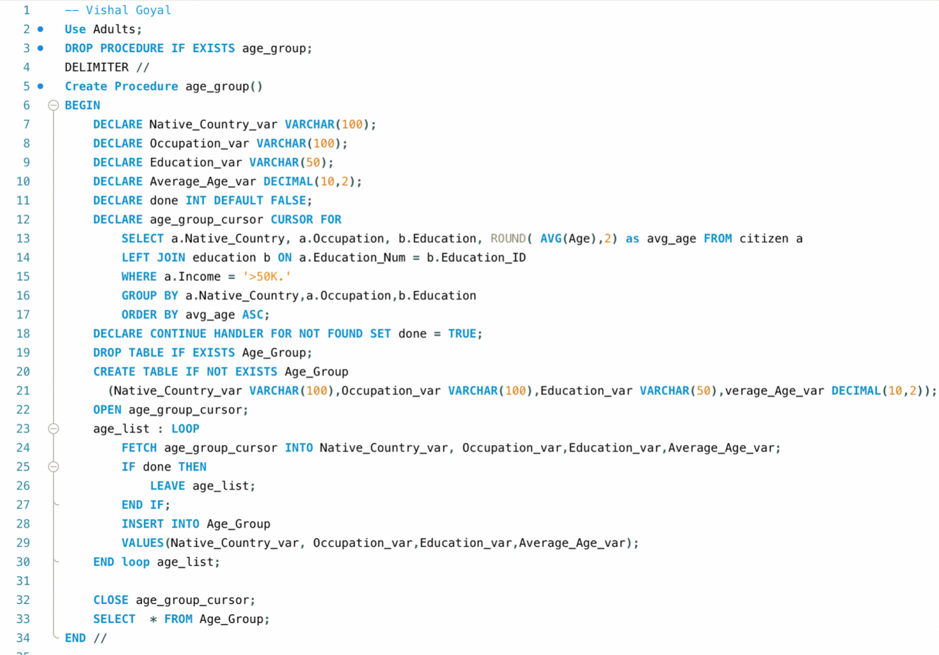

Slide 10
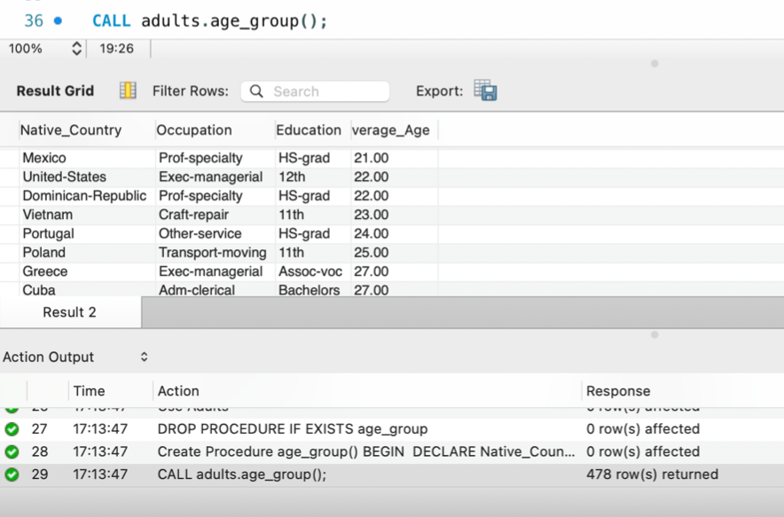
Output Results

Slide 11
Logic 2:-
The number of individuals in each of the Workclass and Education-Num in each Occupation with income in each income level in each Native Country in ascending order.
Categorized all Native Country with Subcategories of all
Income level
Occupation
Education_Num
Workclass
With Number of Individuals

Slide 12
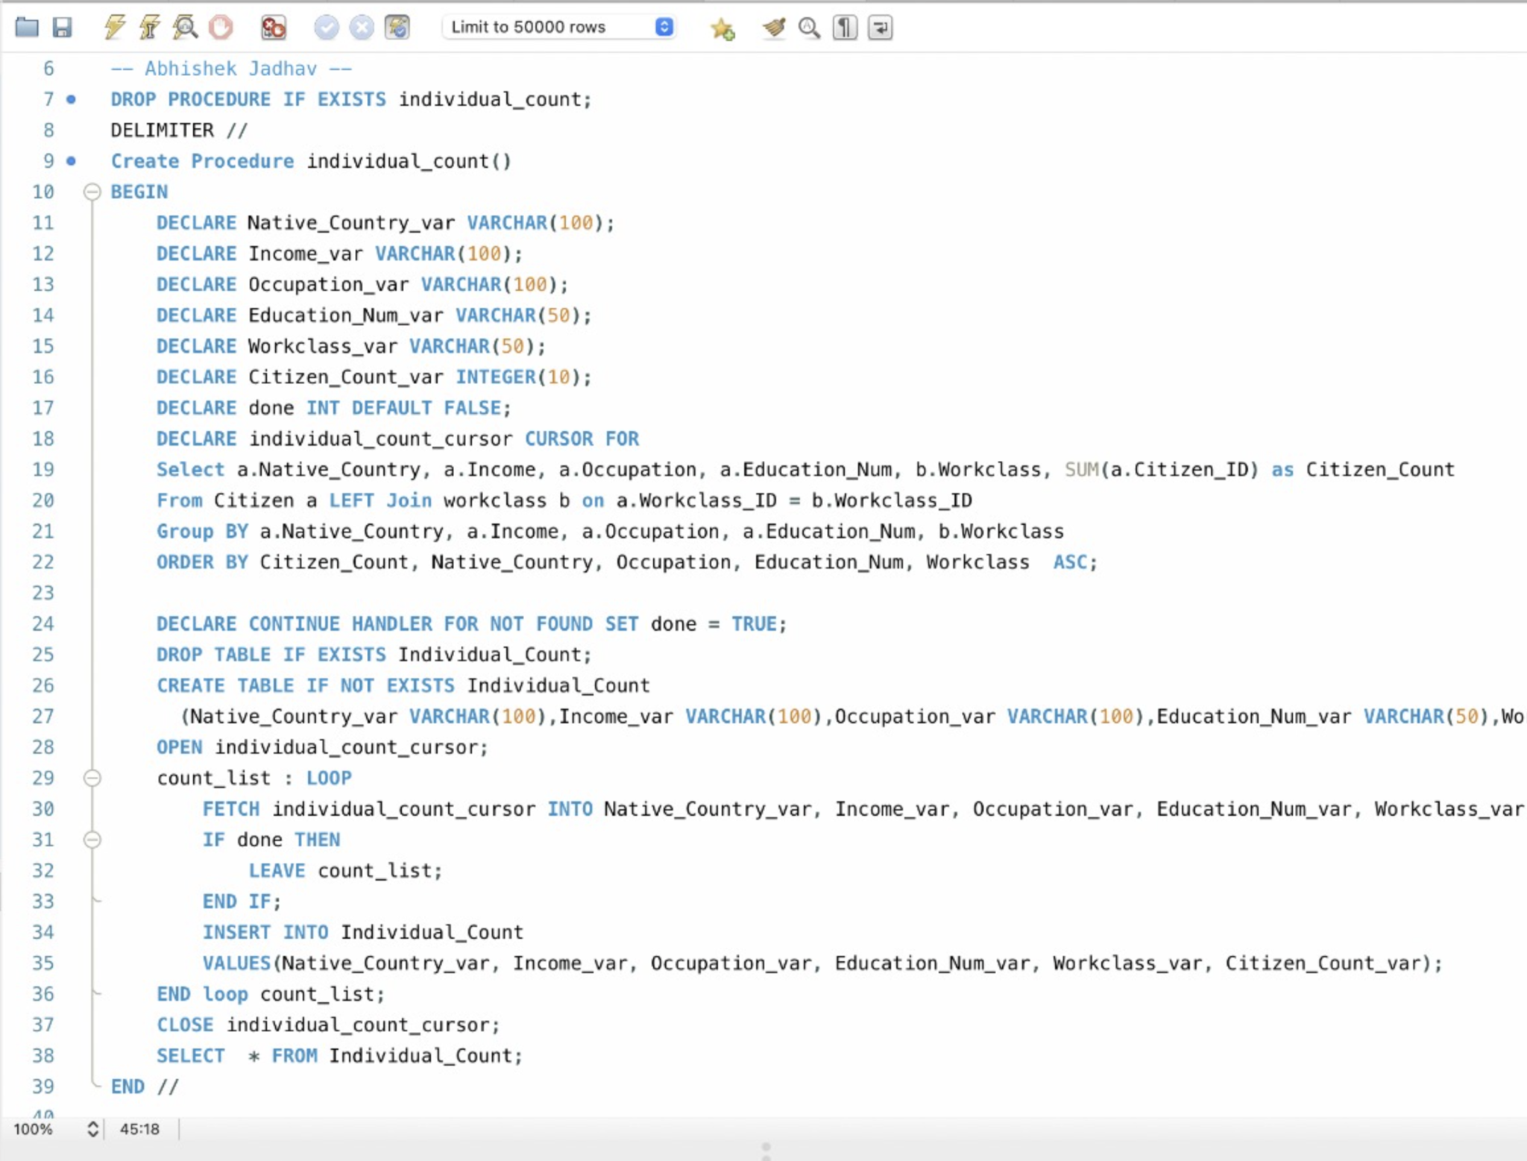

Slide 13
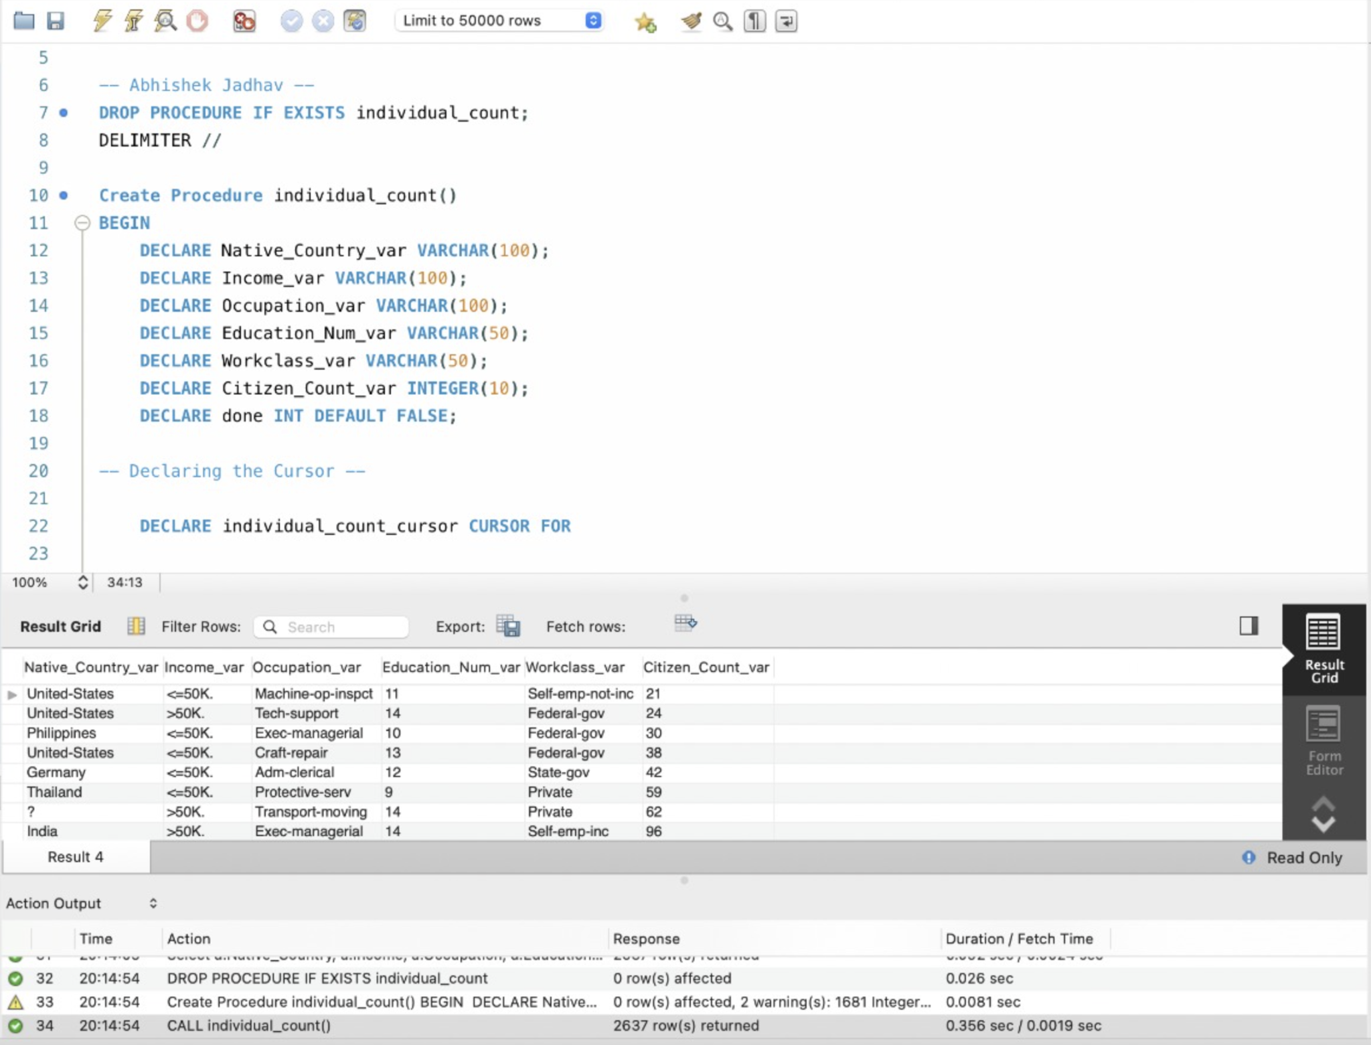
Output Code Screenshot.

Slide 14
Logic 3: The Maximum Capital Gain for Each Race and Gender in Each Native Country in ascending order.
Categorized all Native Country with Subcategories of all
Race
Sex
Capital_Gain
To follow the aim of logic all the fields were available in the Citizen table. The Query was run to
Find the Maximum Capital Gain pertaining to the each Race, Sex and Native Country.

Slide 15
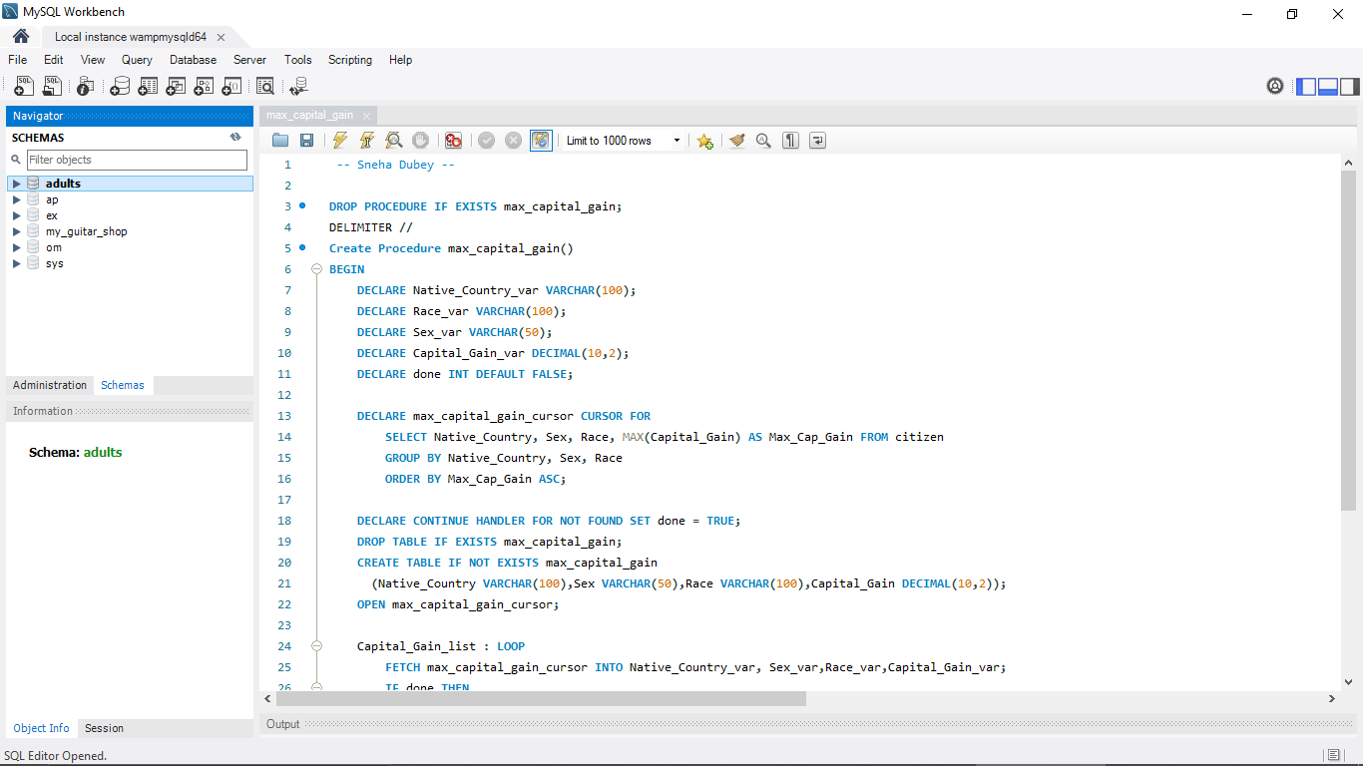

Slide 16
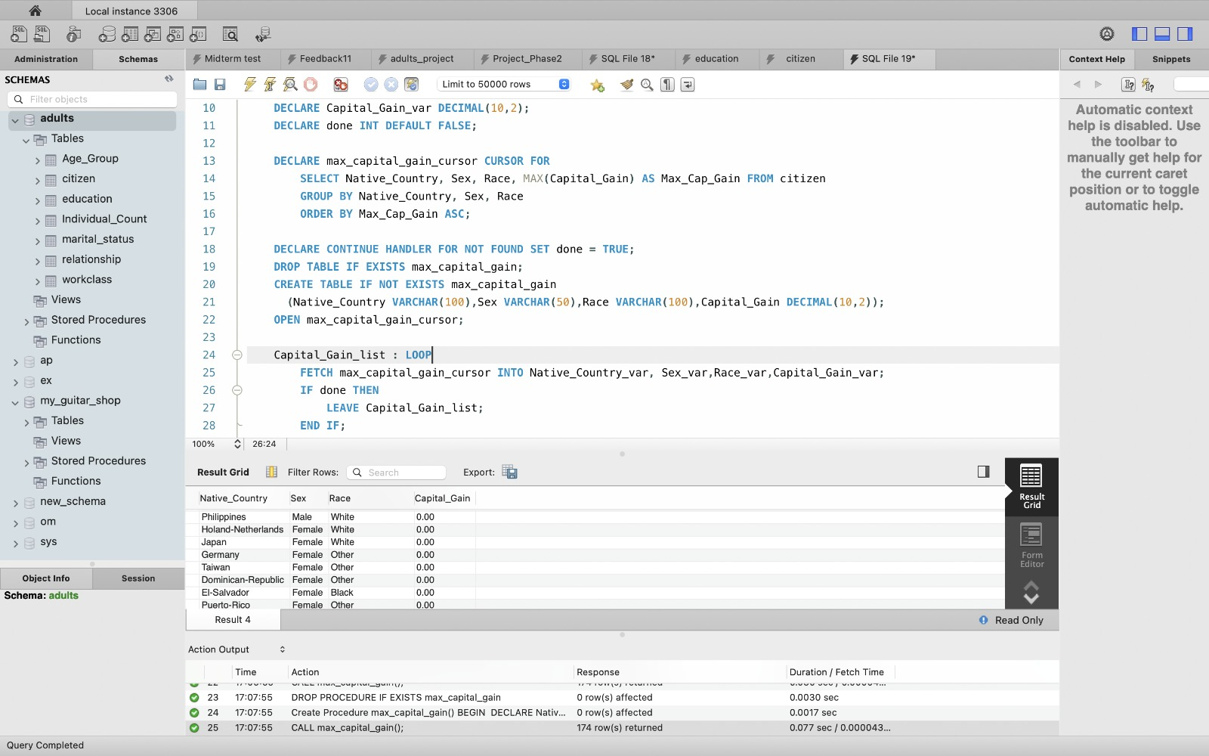

Output for Logic 3:
Sneha Dubey

Slide 17
Logic : 4
The average of the difference of Capital Gain minus Capital Loss for each Marital-Status and Relationship in each Native Country in ascending order.
Categorized all Native Country with Subcategories of all
→ Marital Status
→ Relationship
→ With Average difference of Capital Gain minus Capital Loss.

Slide 18
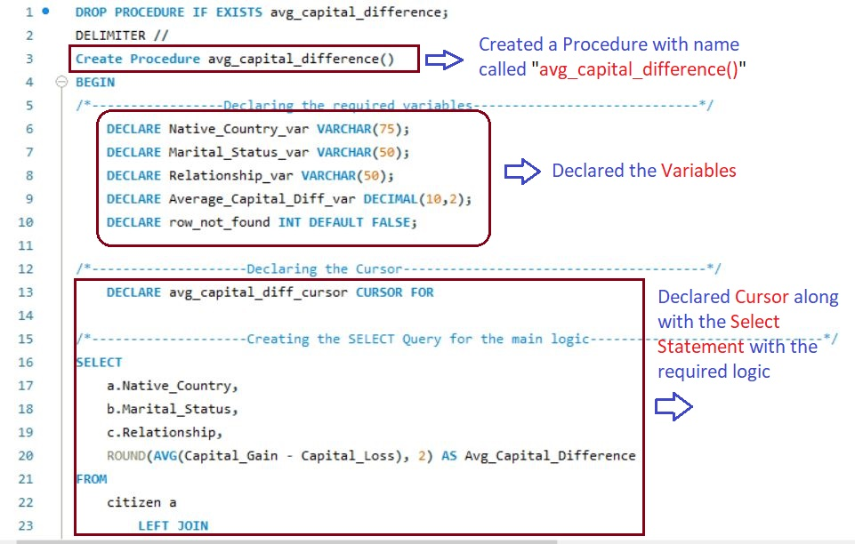
-Ramakrishna Doradla Venkatesh
Notes:
Code of Stored Procedure No 4: Ram

Slide 19
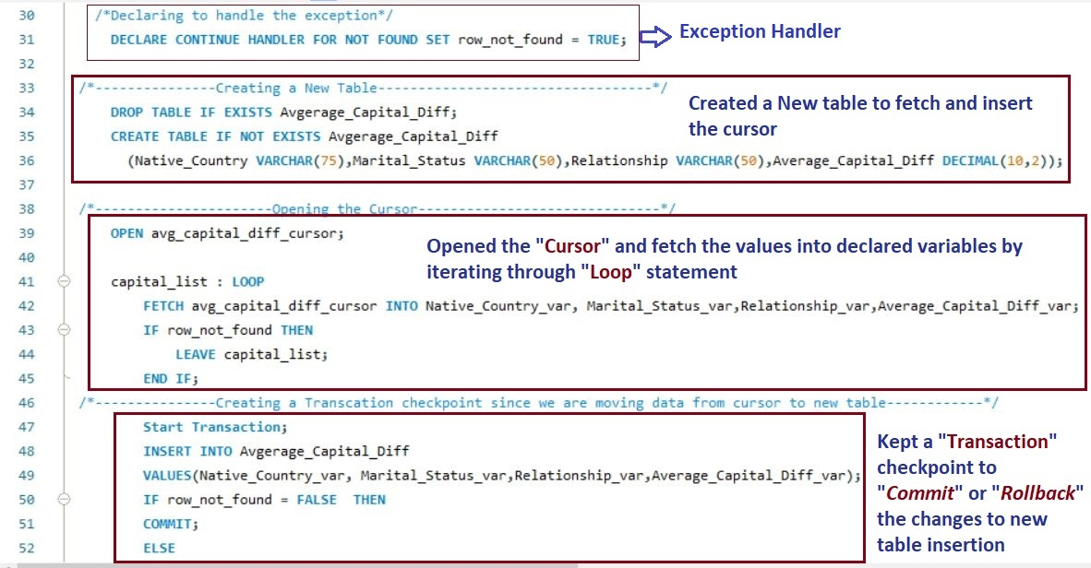
Notes:
Output of Stored Procedure No 4: Ram

Slide 20
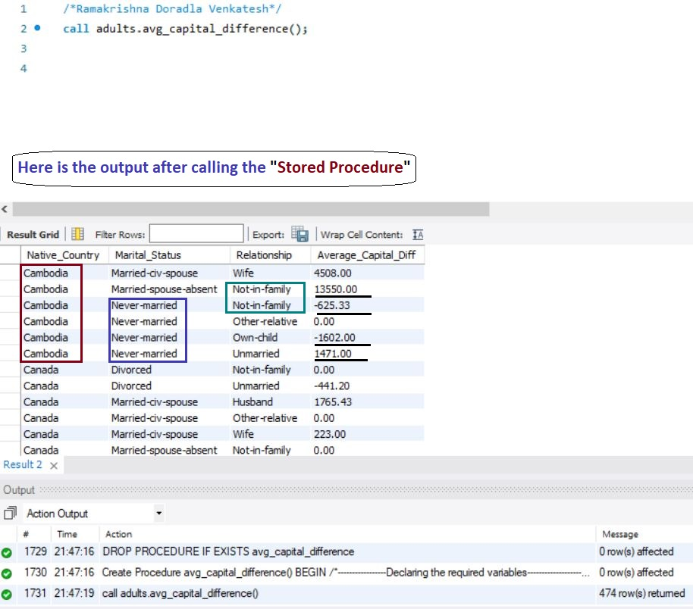
Output Results

Slide 21
Logic : 5
The average Education-num for each Sex, Race and Marital Status in each Native Country in ascending order.
Categorized all Native Country with Subcategories of all
→ Marital Status
→ Sex
→ Race
→ Education

Slide 22
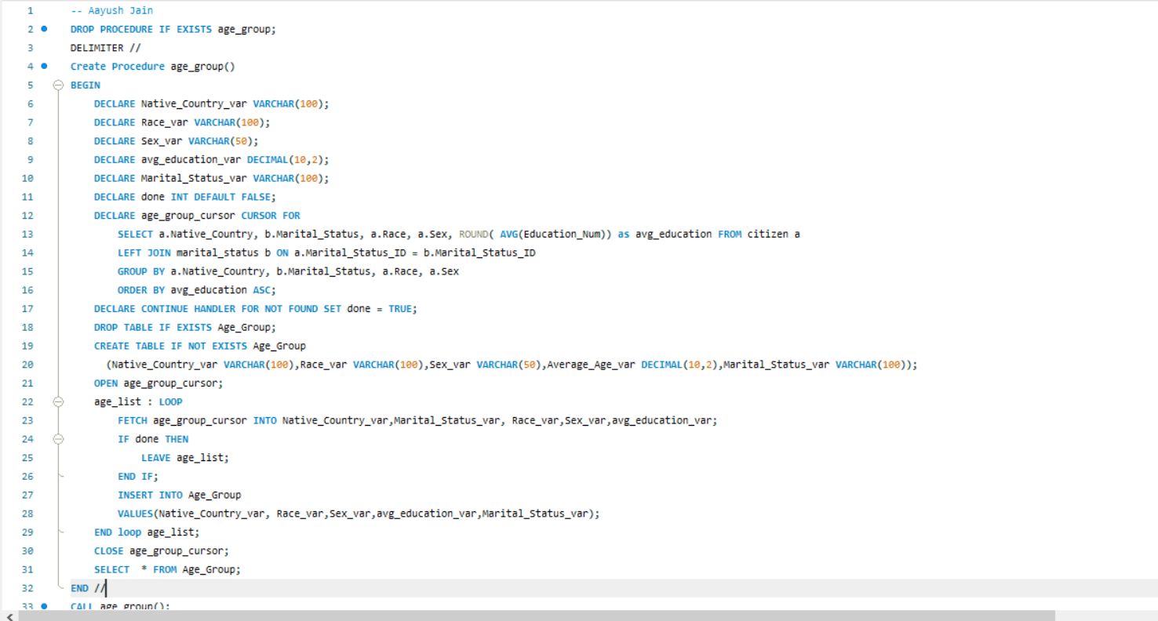
Notes:
Query 5- (Code) Aayush

Slide 23
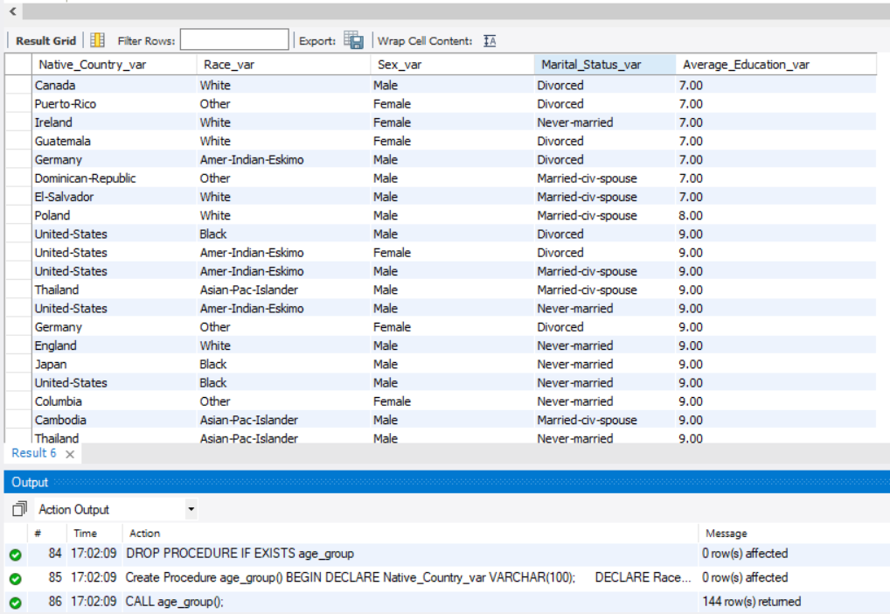
Output Results

Slide 24
Thank You !!!

